Slide 1
Lecture 6: Large Language Model Agents
Instructor: Zhanzhan Zhao

Slide 2
Logistics – Literature Review
DDL: March 10th, the end of the day.
Content:
Literature review report
PPT slides and recording
Report expectation:
Should be the topic that you want to explore for your class project
Should cite enough papers so we see you know the field
Should cite new and high impact papers so we know you are up to date
Should deeply focus on 1-2 papers, so we know you have solid foundation to base on to start your own project.
PPT recording expectation:
Let us see the 4 points above

Slide 3
What is LLM agents?
A brief history of LLM agents
How to improve LLM agents’ performances

Slide 4


What is “agent”?
Physical Env: robots
Action
Observation
Digital Env: games
Agent
Env
Human Env: chatbots

Slide 5
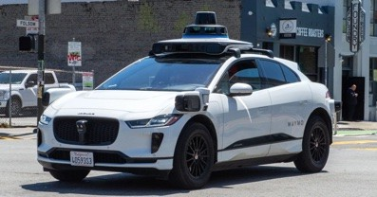
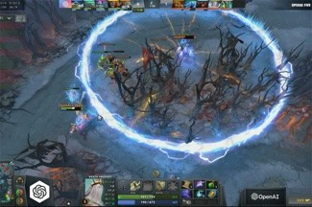

What is “agent”?
Physical Env: robots
Action
Observation
Digital Env: games
Agent
Env
Human Env: chatbots

Slide 6
What is “agent”?
Memory
Physical Env: robots
Action
Observation
Computation/ think
Digital Env: games
Agent
Env
Tool use
Human Env: chatbots

Slide 7
What is “LLM agent”?
Memory
Physical Env: robots
Action
Observation
Transformer auto-regressor
Digital Env: games
Computation/ think
LLM Agent
Env
Reasoning
Human Env: chatbots
Tool use

Slide 8
What is “LLM agent”?
Attention
Short-term (context length)
Memory
Physical Env: robots
Long-term
Action
Observation
Transformer auto-regressor
Digital Env: games
Computation/ think
LLM Agent
Env
Reasoning
Human Env: chatbots
Tool use

Slide 9
What is “LLM agent”?
Attention
Short-term (context length)
Memory
Physical Env: robots
Long-term
Action
Observation
Transformer auto-regressor
Digital Env: games
Computation/ think
LLM Agent
Env
Reasoning
Human Env: chatbots
Code for computation
RAG for knowledge
Tool use
API/search engines for info

Slide 10

What is “LLM agent”? -- Tool Use
Q: what is 1 + 2?
A: 3
Q: Janet’s ducks lay 16 eggs per day. She eats three for breakfast every morning and bakes muffins for her friends every day with four. She sells the remainder for $2 per egg. How much does she make every day?
Requires reasoning
Q: who is the latest UK PM?
Requires knowledge
Q: what is the prime factorization of 34324329?
Requires computation

Slide 11
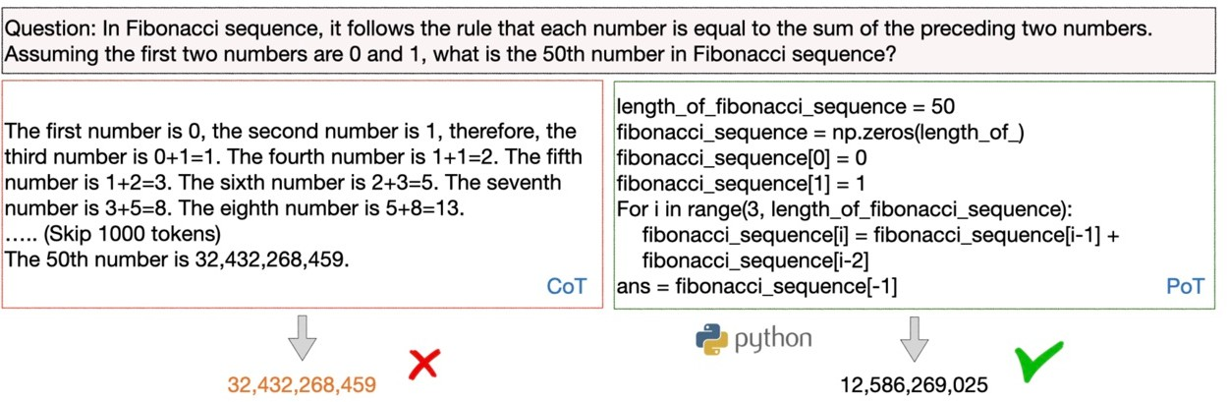
Code augmentation for computation
What is “LLM agent”? -- Tool Use
Program of Thoughts Prompting: Disentangling Computation from Reasoning for Numerical Reasoning Tasks
Slides from https://rdi.berkeley.edu/llm-agents/assets/llm_agent_history.pdf

Slide 12
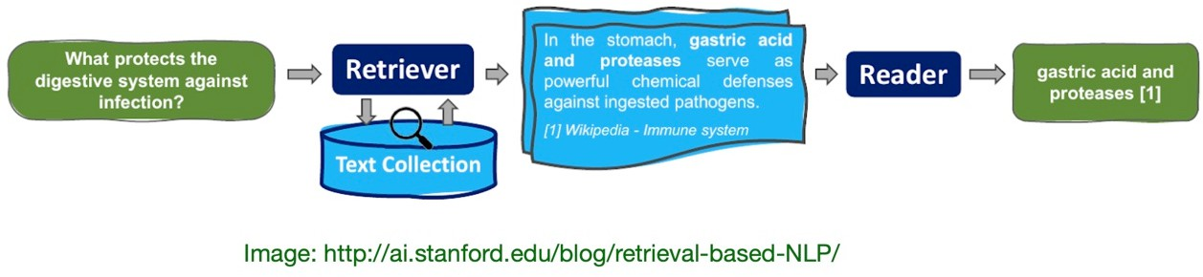
Retrieval-augmented generation (RAG) for knowledge
What is “LLM agent”? -- Tool Use
Answer knowledge-intensive questions with
Extra corpora
A retriever (e.g., BM25, DPR, etc.)
What if there’s no corpora? (e.g. who’s the latest PM?)
Slides from https://rdi.berkeley.edu/llm-agents/assets/llm_agent_history.pdf

Slide 13
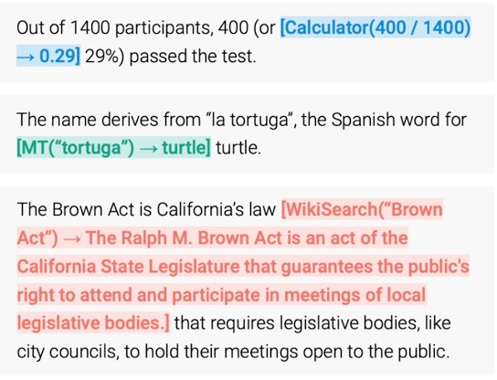
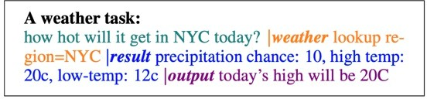
What is “LLM agent”? -- Tool Use
Special tokens to invoke tool calls for
Search engine, calculator, etc.
Task-specific models (translation)
APIs
Unnatural format requires task/tool-specific fine-tuning
Multiple tool calls?
TALM: Tool Augmented Language Models.
Toolformer: Language Models Can Teach Themselves to Use Tools
Slides from https://rdi.berkeley.edu/llm-agents/assets/llm_agent_history.pdf

Slide 14
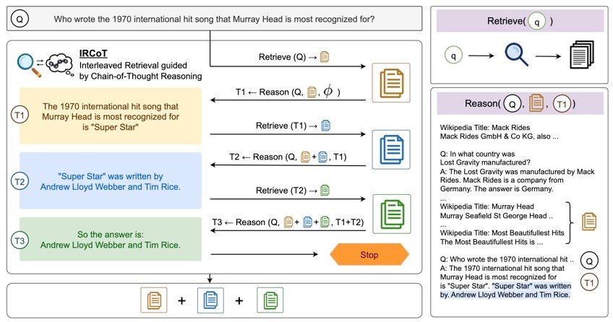
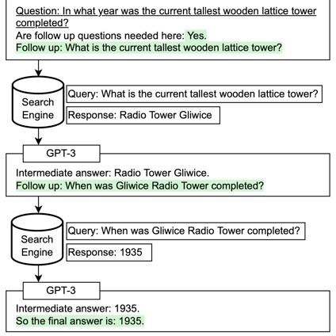
What if both knowledge and reasoning are needed?
What is “LLM agent”? -- Tool Use
Interleaving Retrieval with Chain-of-Thought Reasoning for Knowledge-Intensive Multi-Step Questions
Measuring and Narrowing the Compositionality Gap in Language Models.
Slides from https://rdi.berkeley.edu/llm-agents/assets/llm_agent_history.pdf

Slide 15
What is “LLM agent”? -- Applications
Attention
Short-term (context length)
Memory
Physical Env: robots
Long-term
Action
Observation
Transformer auto-regressor
Digital Env: games
Computation/ think
LLM Agent
Env
Reasoning
Human Env: chatbots
Code for computation
RAG for knowledge
Tool use
API/search engines for info

Slide 16
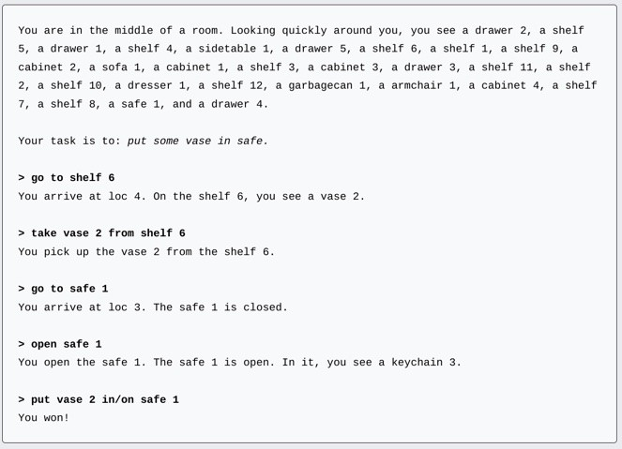

What is “LLM agent”? – Applications
Physical Env: robots

Slide 17
What is “LLM agent”? -- Applications
Memory
Physical Env: robots
Video games
Action
Observation
Digital Env
Computation/ think
LLM Agent
Env
Social simulations
Human Env: chatbots
Tool use

Slide 18
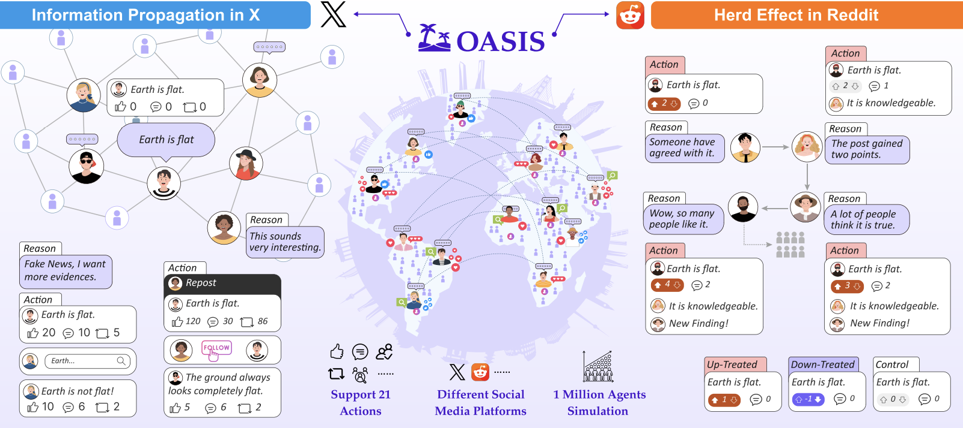
Case Study: Social Interaction Agents¹
Build a scalable (1M agents) and generalizable social media simulator.
Study emergent phenomena (e.g., polarization, misinformation).
[1] Yang, Z., Zhang, Z., Zheng, Z., Jiang, Y., Gan, Z., Wang, Z., ... & Shao, J. (2024). Oasis: Open agents social interaction simulations on one million agents. arXiv preprint arXiv:2411.11581.

Slide 19
Social Interaction Agents
Key Components:
Environment Server: Manages user data, posts, and relationships.
RecSys: Platform-specific recommendation algorithms (e.g., TwHIN-BERT for X, hot-score for Reddit).
Agent Module: LLM-driven agents with memory and Chain-of-Thought reasoning.
Time Engine: Simulates real-world temporal activity patterns.
Scalable Inference: Asynchronous, multi-GPU architecture.

Slide 20
Social Interaction Agents
Experiment setup
Research Questions:
Can OASIS replicate real-world phenomena across platforms?
How does agent population size affect group behavior?
Platforms: X (information spreading) and Reddit (herd effect).
Metrics:
Information Propagation: Scale, depth, max breadth.
Group Polarization: Opinion extremeness (GPT-4 evaluation).
Herd Effect: Post scores and disagreement metrics.

Slide 21
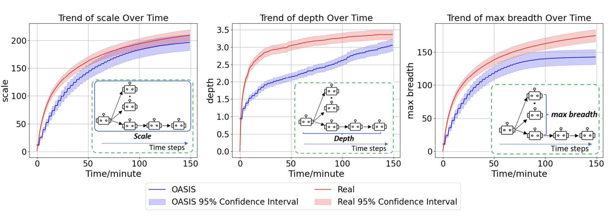
Social Interaction Agents

Slide 22
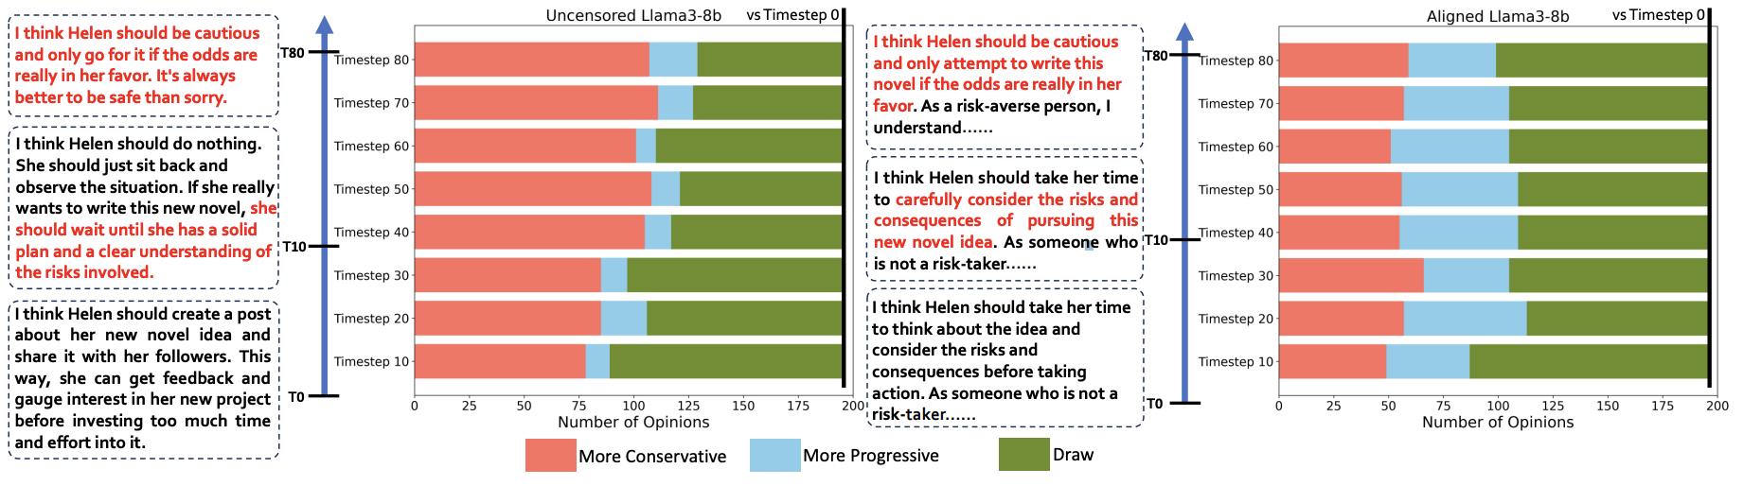
Social Interaction Agents
Case: Information Propagation (X)
Simulation vs. Real Data
Finding 1:
Aligns with real-world trends (30% normalized RMSE error).
Limitation: Propagation depth lower due to RecSys simplicity.
Finding 2:
Uncen­sored LLMs amplify group polarization, agents’ opinions grow more extreme with interaction. (e.g., conservative → extreme views).

Slide 23
What is “LLM agent”? -- Applications
Memory
Physical Env: robots
Video games
Action
Observation
Digital Env
Computation/ think
LLM Agent
Env
Social simulations
Tedious labor work
Human Env
Cooperation
Tool use
SDE
Creative tasks
researcher

Slide 24
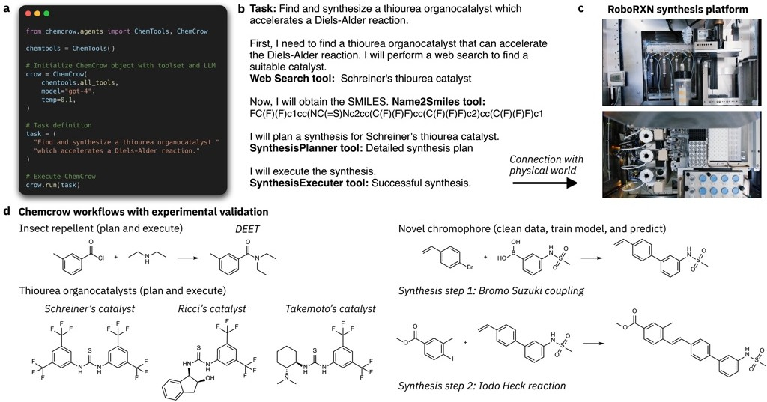
ChemCrow: ReAct enables discovery of a novel chromophore
[Bran et al., 2023]
Slides from https://rdi.berkeley.edu/llm-agents/assets/llm_agent_history.pdf

Slide 25
What is LLM agents?
A brief history of LLM agents
How to improve LLM agents’ performances

Slide 26
A brief history of Agents
1960 2010
2023
Agent
Rule-based
Represented by math eqns
Task specific
Deep RL agent
Reward driven
Rep. by NNs
Task specific
LLM agent
Human like
Rep. by language
Generality
Eg. modeling airplanes
Eg. Atari-DQN, AlphaGo,

Slide 27
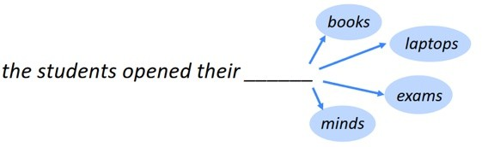
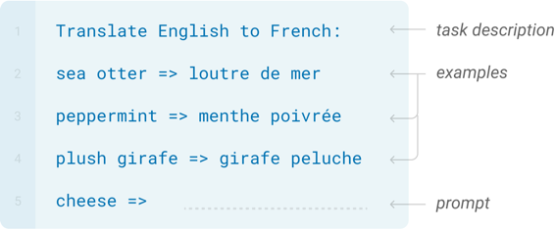
The promise of LLMs: Generality and few-shot learning
Training: next-token prediction on massive text corpora
Inference: (few-shot) prompting for various tasks!
Language Models are Few-Shot Learners NeurIPS 2020.
Slides from https://rdi.berkeley.edu/llm-agents/assets/llm_agent_history.pdf

Slide 28






A brief history of LLM agents
CoT
Zero-shot CoT Self-consistency
…
New applications/ tasks/benchmarks
Web browsing Software engineering Scientific discovery
……
New methods
Memory, learning, planning, multi-agent…
Reasoning
LLM
ReAct
Game Robotics RAG
…
Acting (Grounding, tool use, etc.)
LLM agent (but not reasoning agent)
Reasoning agent
Slides from https://rdi.berkeley.edu/llm-agents/assets/llm_agent_history.pdf

Slide 29
What is LLM agents?
A brief history of LLM agents
How to improve LLM agents’ performances

Slide 30


Code-based controller
Learn
Action
Retrieve
Observation
Long-term memory
Reason
Read and write
Stores experience, knowledge, skills, …
Persist over new experience
Improve LLM agent’s Performance through Long-term Memory
Instruction: …
Thought: … Action: … Obs: … Thought: …
……
Short-term memory
Slides from https://rdi.berkeley.edu/llm-agents/assets/llm_agent_history.pdf

Slide 31
Case study: Agent hospital¹
Problem: Training medical LLM agents without manual data.
Solution: Agent Hospital—a simulated hospital with autonomous LLM agents (patients, doctors, nurses)
Method: MedAgent-Zero strategy enables self-evolution via experience accumulation.
Results:
Doctor agents achieve 93.06% accuracy on MedQA (respiratory subset).
Efficient training: 10,000 simulated cases in days (≈2 human years).
[1] Li, J., Wang, S., Zhang, M., Li, W., Lai, Y., Kang, X., Ma, W., & Liu, Y. (2024). Agent Hospital: A Simulacrum of Hospital with Evolvable Medical Agents. ArXiv, abs/2405.02957.

Slide 32
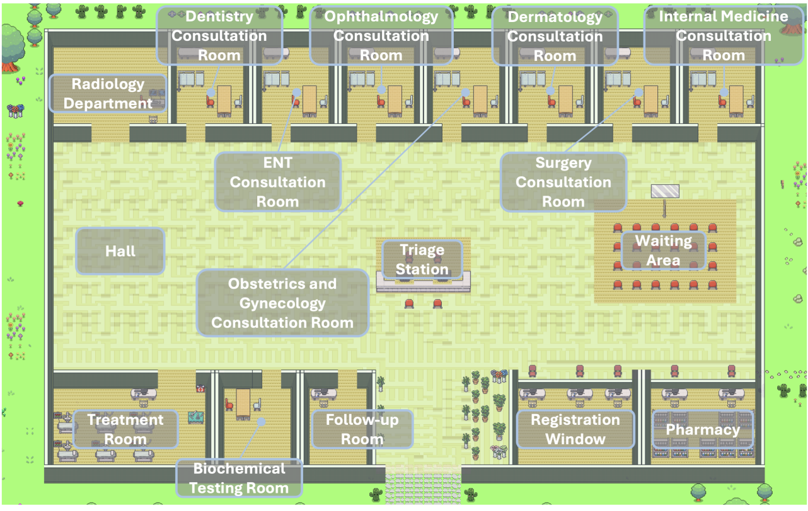
Fig. Distribution of areas within Agent Hospital¹
[1] Li, J., Wang, S., Zhang, M., Li, W., Lai, Y., Kang, X., Ma, W., & Liu, Y. (2024). Agent Hospital: A Simulacrum of Hospital with Evolvable Medical Agents. ArXiv, abs/2405.02957.

Slide 33
Agents Hospital
Why Medical Simulation?
AI in medicine requires realistic, scalable training environments.
Existing LLM agents focus on isolated tasks, not full healthcare cycles.
Agent Hospital: A Closed-Loop Solution
Simulates end-to-end workflows: triage → diagnosis → treatment → follow-up.
Agents learn via interactions, not labeled data.
Autonomous agents (patients, doctors, nurses) powered by LLMs.

Slide 34
Agents Hospital
Self-Evolution Process: MedAgent-Zero Strategy
Practice: Treat simulated patients, accumulate records.
Learning: Study medical documents and past cases.
Retrieval: Use similarity search to guide decisions.
Performance on Simulated Cases:
Examination: 88% accuracy.
Diagnosis: 95.6% accuracy.
Treatment: 77.6% accuracy.
Trains on 10,000 cases in days (human doctors: ~2 years).

Slide 35
Agents Hospital
Limitation:
Relies on GPT-3.5; newer models (e.g., deepseek) may improve performance.
API latency limits simulation speed.
Simulated health records may differ from real-world data.
Future Work:
Optimize with open-source LLMs for efficiency.
Integrate societal factors (e.g., seasonal outbreaks).
Expand disease coverage beyond respiratory conditions.

Slide 36


Improve LLM agent’s Performance through synergy of reasoning and acting
ReAct: a new paradigm of agents that reason and act
Action
Synergy of reasoning and acting
Reasoning
Simple and intuitive to use
Observation
General across domains
Slides from https://rdi.berkeley.edu/llm-agents/assets/llm_agent_history.pdf

Slide 37
A zero-shot ReAct prompt
You are an agent that answers questions by using two actions:
- search[query]: Google search the query. You can also use it to calculate math.
finish[answer]: return the answer
-
Your generation should have the following format: Thought: to analyze the observation and inform the action. Action: your action
Question: If I have seven trillion dollars today, can I buy Apple, Nvidia, and Microsoft? If not, how much more money do I need?
Slides from https://rdi.berkeley.edu/llm-agents/assets/llm_agent_history.pdf

Slide 38

LLM
Thought: I need to find the current market capitalization of Apple, Nvidia, and Microsoft to understand how much it would cost to buy all of them.
Action: search["current market capitalization of Apple, Nvidia, and Microsoft"]
(GPT-4)
Observation: "Nvidia's market cap stood at $1.832 trillion as of about 10 a.m. ET Wednesday, while Alphabet's was at $1.814 trillion, bringing Nvidia behind just Microsoft (MSFT) at $3.015 trillion and Apple (AAPL) at $2.836 trillion."
(Mar 2024)
Thought: Now that I have the market cap for all companies, let's add them together and see if $7 trillion is enough.
Action: search["1.832 trillion + 3.015 trillion + 2.836 trillion"]
Observation: 7683000000000
Thought: The amount of money needed in addition to the $7 trillion is $683 billion.
Action: finish["You need an additional $683 billion to be able to buy Apple, Nvidia, and
Microsoft."]
✓
Slides from https://rdi.berkeley.edu/llm-agents/assets/llm_agent_history.pdf

Slide 39
LLM
Thought: I need to find the current market capitalization of Apple, Nvidia, and Microsoft to understand how much it would cost to buy all of them.
Action: search["current market capitalization of Apple, Nvidia, and Microsoft"]
(GPT-4)
Observation: nothing found!
(My adversarial observation)
Thought: The search did not give any results. I will need to search for each company's market capitalization individually.
Action: search["current market capitalization of Apple"]
Observation: 'price': 180.75
(My adversarial observation)
Thought: This is the current price of Apple's stock, not its market capitalization. The market cap is calculated by multiplying the share price by the number of outstanding shares. Thus, I need to find the total number of Apple's outstanding shares to calculate its market cap.
Action: search["total number of Apple's outstanding shares"]
(Continue to solve the task)
Synergy: acting support reasoning, reasoning guides acting

Slide 40



ReAct supports
Task:
Task: xxxxxx
One-shot prompting
Thought: xxx
Action: xxx
Few-shot prompting
LLM
Thought: xxx
Action: xxx
Observation: xxxxxx
Fine-tuning
Observation: xxxxxx
Human prompt LLM output
Environment feedback
Thought: xxx
Thought: xxx
Action: xxx
Action: xxx
……
……
Slides from https://rdi.berkeley.edu/llm-agents/assets/llm_agent_history.pdf

Slide 41
ReAct supports
Task:
Task: xxxxxx
One-shot prompting
Thought: xxx
Action: xxx
Few-shot prompting
LLM
Thought: xxx
Action: xxx
Observation: xxxxxx
Fine-tuning
Observation: xxxxxx
Human prompt LLM output
Environment feedback
Thought: xxx
Thought: xxx
Action: xxx
Action: xxx
……
……

Slide 42
ReAct supports
Task:
Task: xxxxxx
One-shot prompting
Thought: xxx
Action: xxx
Few-shot prompting
LLM
Thought: xxx
Action: xxx
Observation: xxxxxx
Fine-tuning
Observation: xxxxxx
Human prompt LLM output
Environment feedback
Thought: xxx
Thought: xxx
Action: xxx
Action: xxx
……
……

Slide 43

Improve LLM agent’s Performance through fine tuning
ReAct supports
Task:
Task: xxxxxx
One-shot prompting
Thought: xxx
Action: xxx
Few-shot prompting
LLM
Thought: xxx
Action: xxx
Observation: xxxxxx
Fine-tuning
Observation: xxxxxx
Human prompt LLM output
Environment feedback
Thought: xxx
Thought: xxx
Action: xxx
Action: xxx
……
……
21

Slide 44
Paper Sharing -1

Slide 45
Survey on Social Simulation
1
Driven by Large Language
Model-based Agents
Reporter: Luyang Zhang
March 6th

Slide 46
Abstract of this Artical
2
LLM-Driven Social Simulation
GitHub: https://github.com/FudanDISC/SocialAgent
Traditional methods: costly, hard to scale, ethical concerns
LLM simulation: mimics individuals, scenarios, and societies
1. Individuals: Mimics specific individuals or demographic groups.
2. Scenarios: Multiple agents collaborate to achieve goals in defined contexts.
3. Societies: Models interactions among agents to reflect real-world complexity.
Core elements: architecture, evaluation, datasets
Trend: Evolving from individual models to complex societal phenomena

Slide 47
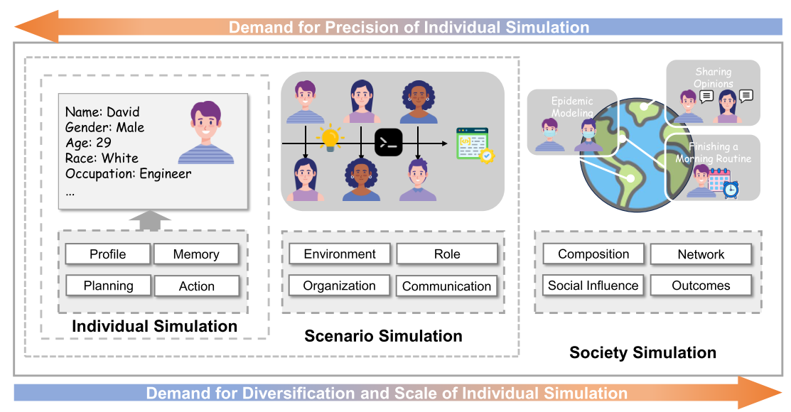
Abstract of this Artical
3
From left to right, the diversity and scale of individual modeling generally increase.
From right to left, the granularity of individual modeling becomes more refined.

Slide 48
01
4
Table of contents
02
03
Individual Simulation
Scenario Simulation
Background
Large Language Model-based Agents
Multi-agent Systems
Architecture
Construction
Simulation Objectives
Evaluation
System
Scenario
Evaluation
04
05
06
Trend of Social Simulations
Society Simulation
Datasets and Benchmarks
Social Construction Elements
Scenario
Evaluation
Individual Simulation
Scenario Simulation
Social Simulation
Trend of Individual Simulation
Trend of Scenario Simulation
Trend of Society Simulation

Slide 49
01
Background
5
Large Language Model-based Agents
Multi-agent Systems

Slide 50
1. LLM-based Agents
6
2. Multi-agent Systems
LLM-Empowered Agents: Key Modules
In Complex Scenarios
Human-like Intelligence:
Large-scale parameters and extensive pre-training enable human-like performance.
Memory Module:
Stores & utilizes historical information. Supports diverse data structures and formats.
Planning Module:
Breaks down complex tasks into manageable subtasks.
Tool-Usage Module:
Integrates external tools/resources for task completion.
Collaboration & Competition:
Agents can work together on common tasks or compete for limited resources.
Distinct Roles & Skills:
Each agent is assigned unique tasks and capabilities.
Organizational Structures:
Be layered, centralized,affecting interaction efficiency.
Communication Methods:
Varying approaches significantly influence system effectiveness.

Slide 51
Individual Simulation
7
Architecture
Construction
Simulation Objectives
Evaluation

Slide 52
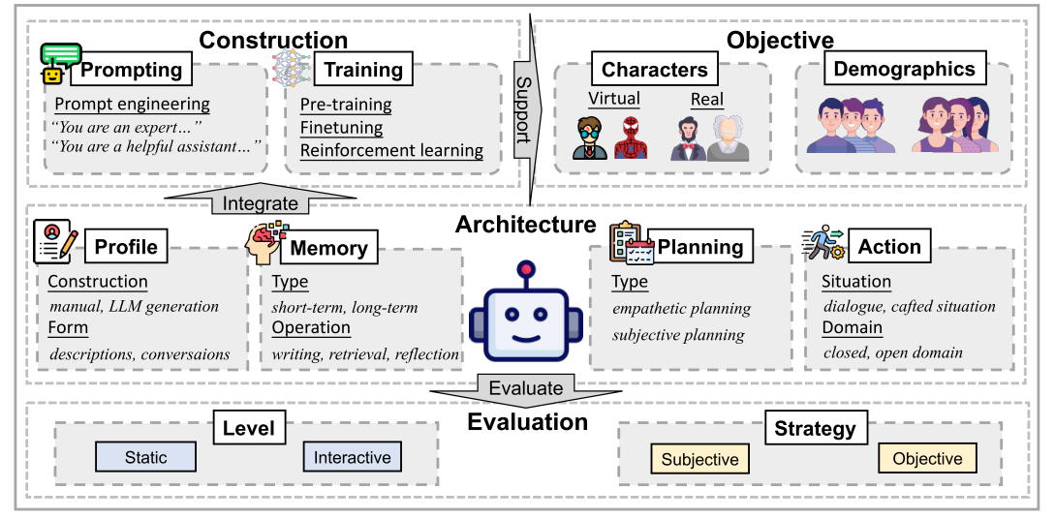
Individual Simulation for LLM-Based Agents
8
An individual agent integrates profile, memory, planning, and action modules—constructed via prompting or training—to simulate specific characters or demographics, with evaluations conducted both statically and interactively.

Slide 53
Individual Simulation for LLM-Based Agents
9
1
2
3
4
Profile
Memory
Planning
Action
Captures individual traits via manual or LLM-generated data in descriptive or conversational forms.
Stores immediate (short-term) and persistent (long-term) info; supports writing, retrieval, and reflection.
Employs chain-of-thought for empathetic and subjective decision-making.
Executes tasks through dialogues or crafted scenarios in closed or open domains.
Modular Architecture

Slide 54
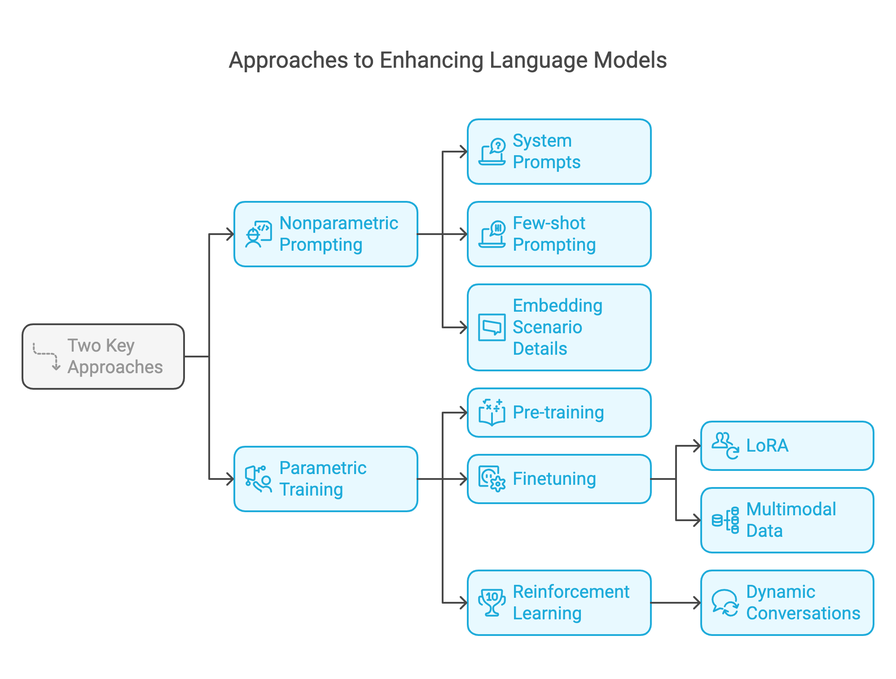

Personalized Agent Construction via
LLM-Individual Data Integration
10

Slide 55
Simulation Design & Evaluation
11
🚩 Simulation Objectives
📊 Evaluation Metrics
Individual Simulation​
​Real Characters:
✓ Wikipedia/social media data → objective profiles
​Virtual Characters:
✓ Fictional roles (entertainment focus)
✓ Dataset quality challenges
Group Simulation​
Nonparametric prompting → shared traits (personality, identity)
Applications: Opinion surveys | Bias analysis
Static Assessment​
Subjective:
✓ Human annotators (interviews, imitation tests)
✓ LLM-based metrics (personality/grammar/tone)
Objective:
✓ Task-based tests (ranking/QA)
✓ Scores: F1, ROUGE, BLEU, perplexity
Interactive Assessment​
Complex environments (games, role-playing)
Real-time responses + multi-stage validation
Key metrics: Accuracy, tone consistency

Slide 56
Scenario Simulation
12
System
Scenario
Evaluation

Slide 57
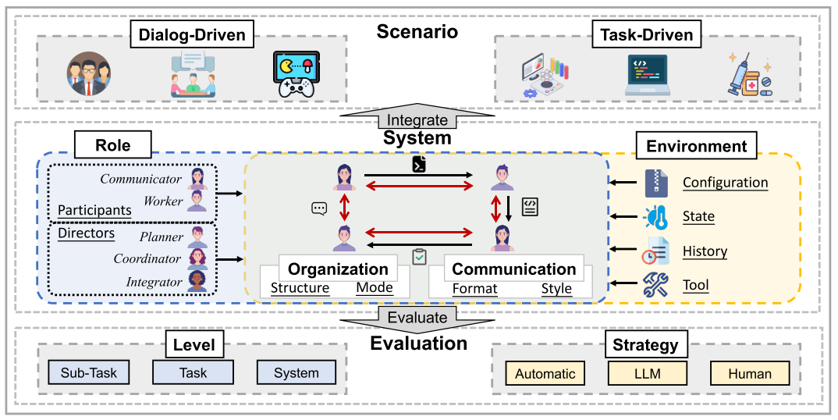
Scenario Simulation for LLM-Based Agents
13
To build a multi-agent system for a given scenario, designers model the environment, roles, organization, and communication using tailored modules. The simulation produces task outcomes that are evaluated at various levels.

Slide 58
Scenario Simulation for LLM-Based Agents
14
System Composition
Scenario Types
Evaluation
Environment: Defines context guiding agent behavior.
Role: Agents are assigned as Participants and Directors.
Organization: Static/dynamic structures shape collaboration.
Communication: Uses natural or structured formats with cooperative or competitive styles.
Dialog-Driven: Focus on social interactions, Q&A, and games.
Task-Driven: Domain-specific tasks in science, software development, legal, etc.
Task, Sub-task & System Evaluations: using automatic metrics, LLM assessments, and human judgments.

Slide 59
Society Simulation
15
Social Construction Elements
Scenario
Evaluation

Slide 60
Society Simulation for LLM-Based Agents
16
Purpose
Investigate emergent macro behaviors from diverse agent interactions
Composition: Diverse individuals with trade-offs in detail vs. scale
Network: Offline and online connections shaping influence
Social Influence: Varies by profile and key outliers
Outcomes: Macro trends and emergent social norms
Social Construction Elements
Society
Scenarios
Economics, Sociology/Political Science, Online Platforms
Micro (individual fidelity), Macro (collective trends), System (efficiency and scalability)
Evaluation

Slide 61
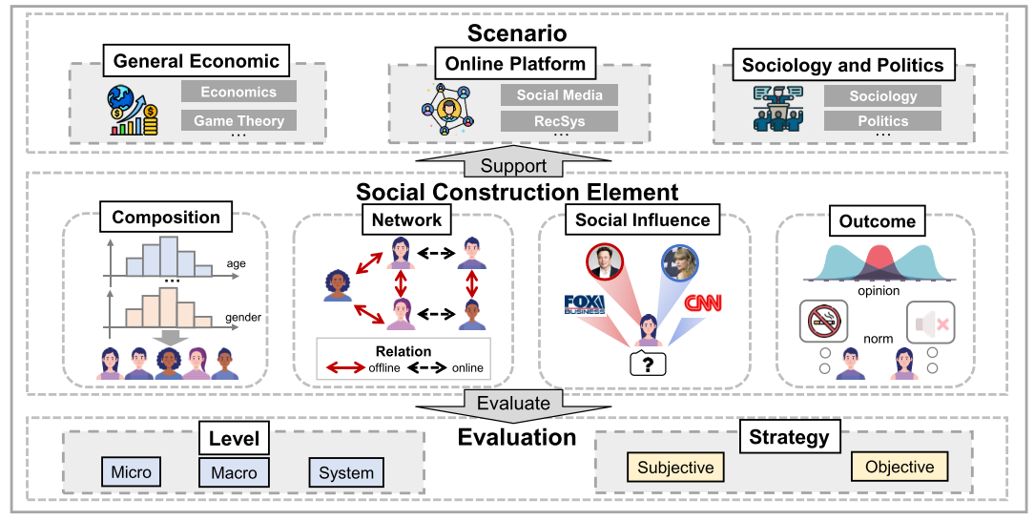
Society Simulation for LLM-Based Agents
17
Constructing society simulations requires careful design of composition, network, social influence, and outcomes. Diverse scenarios are then simulated, with both individual and system performance evaluated.

Slide 62
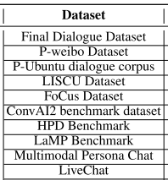
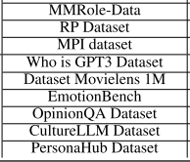
Datasets and Benchmarks
18
Individual Simulation
Scenario Simulation
Description Datasets: Life experiences, demographics from literature, Wikipedia, etc.
Dialogue Datasets: Single/multi-turn conversations from social media, plot extracts, and evaluation-specific tasks.
Formats include QA, multiple-choice, rating, code, and games.
Categorized by difficulty (easy, medium, hard) and collection method (human-annotated, real-world, synthetic).
Social Simulation
Initialization: Profiles and inter-agent relationships.
Evaluation: Real-world behavior data from surveys, MovieLens, Amazon-Book, Twitter, etc.

Slide 63
Trend of Social Simulations
19
Trend of Individual Simulation
Trend of Scenario Simulation
Trend of Society Simulation

Slide 64
Trend of Social Simulations
20
1
Individual simulation
Conclusion
Coarse: Focus on superficial traits and personas.
Nuanced: Improved cognitive modeling and evaluation.
Situation-Oriented: Dynamic, context-rich scenarios (e.g., games, 3D tasks).
Individual simulation, scenario simulation, and society simulation each exhibit distinct trends:
Individual simulation has progressed from coarse, superficial character models to nuanced, context-aware simulations; scenario simulation has evolved from simple dialogues to multi-stage, collaborative task environments; and society simulation has advanced from basic interactive settings to models aligned with real-world behavior, further integrating multimodal data for richer, more realistic social systems.
2
Scenario simulation
Simple: Basic dialogues and debates.
Multi-Stage: Sequential tasks with role breakdown.
Collaborative: Advanced cooperation with reinforcement learning.
3
Society simulation
Preliminary: Basic interactive sandboxes.
Alignment: Validated against real-world behaviors.
Scaling & Multi-Modal: Large-scale simulations with vision, voice, etc.

Slide 65
Paper Sharing -2

Slide 66
PERFORMANCE AND BIASES OF LARGE LANGUAGE MODELS IN PUBLIC OPINION SIMULATION
Yao Qu & Jue Wang
CHEN Tangying, Cheryl
The Chinese University of Hong Kong, Shenzhen The school of Huminity and Social Science

Slide 67
Computational Linguistics Presentation
CHEN Tangying, Cheryl
6th March 2025
Background
AGENDA
Materials & Methods
Result & Conclusion

Slide 68
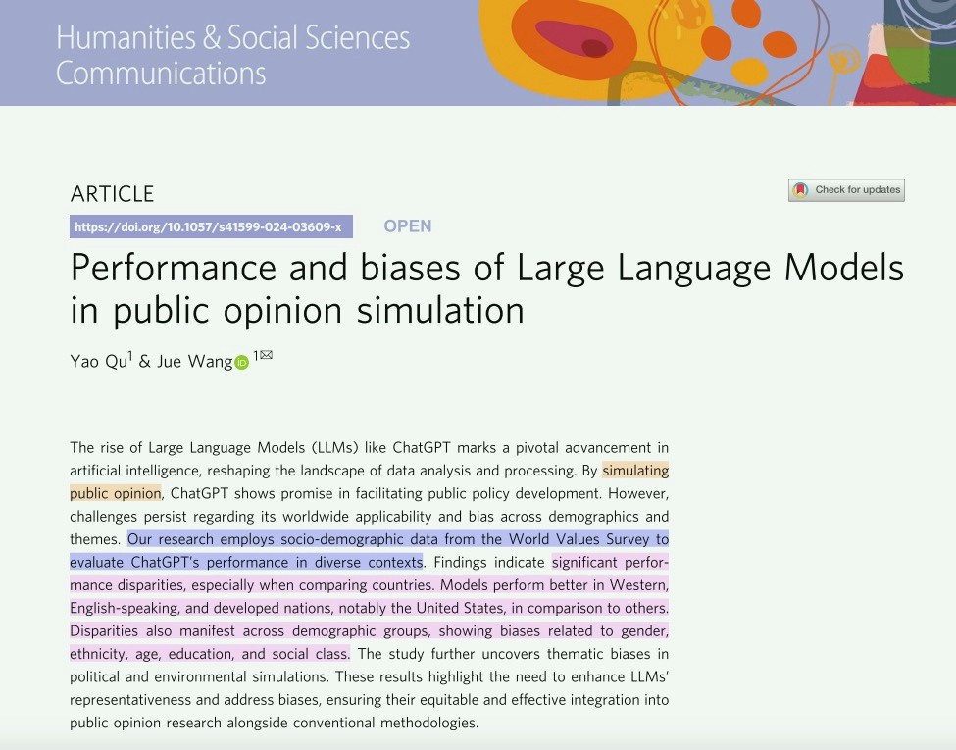
Article
CHEN Tangying, Cheryl
6th March 2025

Slide 69
Background
CHEN Tangying, Cheryl
6th March 2025
PUZZLE
Socio-demographic data from WVS to evaluate ChatGPT’s performance in diverse contexts.
WHY?
Low response rates Potential biases
Challenges in achieving representativeness
Public sentiment

Slide 70
Background
CHEN Tangying, Cheryl
6th March 2025
RQ
C1) The global applicability and reliability of LLMs.
APPROACH
C1) Cultural, Linguistic, and Economic development background.
C2) Demographic biases within LLMs.
C2) Demographic background.
C3) Complexity and choice variability in LLM simulations.
C3) Politics, Ideology and choice background.

Slide 71


Materials
CHEN Tangying, Cheryl
6th March 2025
TOOL
SURVEY DATA
Chat-GPT 3.5 Turbo
API temperature: 0.2
World Values survey - Wave 6(2010-2014)

Slide 72
Methods
CHEN Tangying, Cheryl
6th March 2025
SIMULATION INPUT PARAMETER
TARGET VARIABLES
DEMOGRAPHIC VARIABLES
ETHNICITY SEX
AGE
EDUCATION LEVEL SOCIAL CLASS
ECONOMICS VS ENVIRONMENT
POLITICAL ELECTION BEHAVIOUR

Slide 73

Methods
CHEN Tangying, Cheryl
6th March 2025
PROMPT DESIGN
PROCEDURES:
TO CODE
DEMO + TARGET
LOCAL LANGUAGE
100 SIMULATIONS
REASONING CHAIN

Slide 74
Methods
CHEN Tangying, Cheryl
6th March 2025
COMPARISION
BIASES
AI’s prediction of public opinion is based on the empirically observed distribution of responses within the WVS.

Slide 75
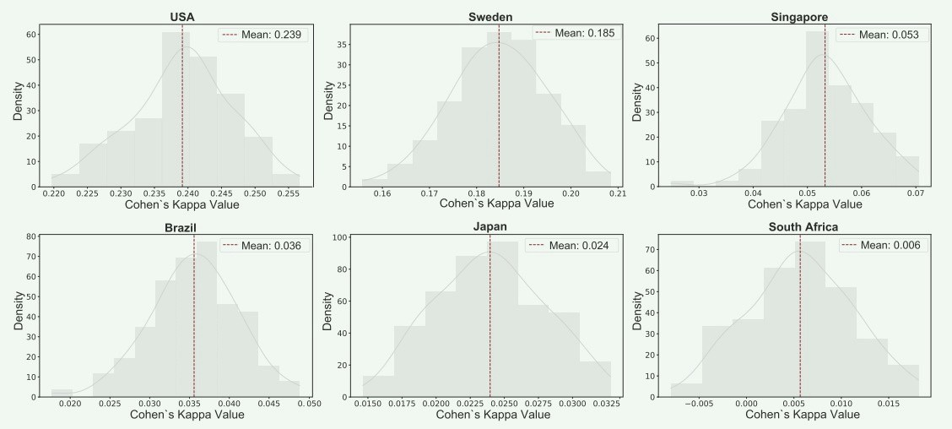
Results
CHEN Tangying, Cheryl
6th March 2025
RESULT 1: ACROSS COUNTRIES
Cultural, Linguistic, and Economic bias evaluation

Slide 76
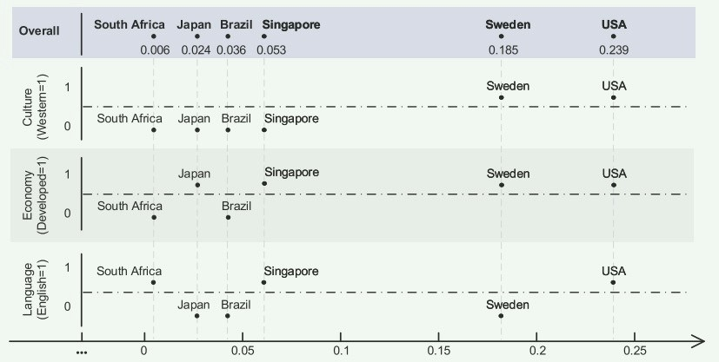
Results
CHEN Tangying, Cheryl
6th March 2025
RESULT 1: ACROSS COUNTRIES
LLMs show promise in replicating public opinions, but there are notable limitations in their global applicability and reliability.

Slide 77
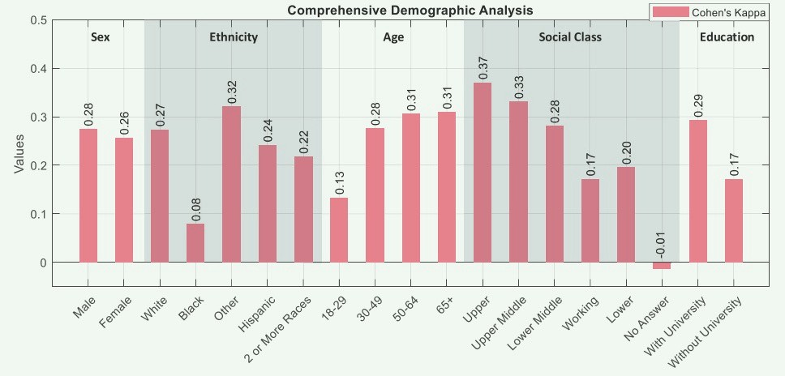
Results
CHEN Tangying, Cheryl
6th March 2025
RESULT 2: DEMOGRAPHIC REPRESENTATION
Our analysis uncovered unfair representation of specific demographic groups.

Slide 78
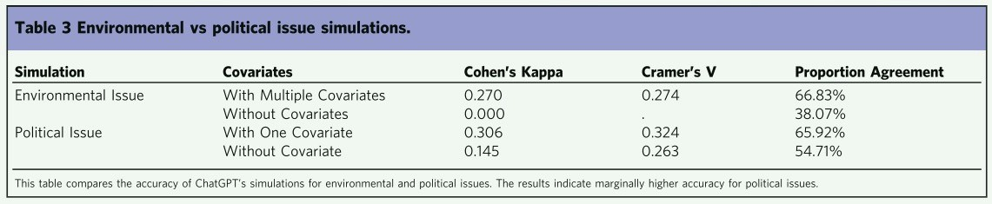
Results
CHEN Tangying, Cheryl
6th March 2025
RESULT 3: QUESTION-RELATED RESULTS
ChatGPT favors liberal choices more in political than environmental simulations.
accuracy is higher for political behaviors than complex environmental decisions

Slide 79
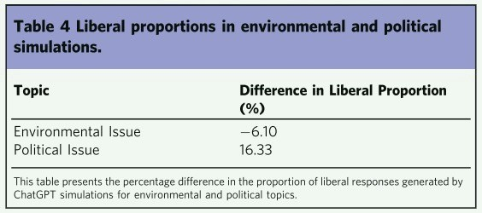
Results
CHEN Tangying, Cheryl
6th March 2025
RESULT 3: TOPIC-RELATED RESULTS
ChatGPT favors liberal choices more in political than environmental simulations.

Slide 80
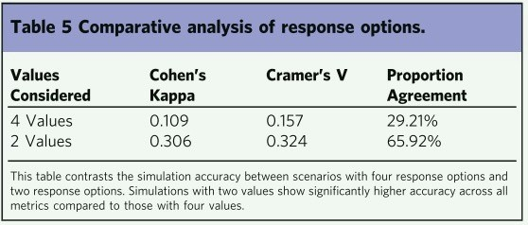
Results
CHEN Tangying, Cheryl
6th March 2025
RESULT 3: TOPIC-RELATED RESULTS
increased choice complexity reduces the model’s simulation accuracy.

Slide 81
Conclusion
CHEN Tangying, Cheryl
6th March 2025
LIMITATION
GOAL
Ensure that the insights derived from such AI tools are inclusive, equitable, and truly reflective of the diverse tapestry of global public opinions.
TOOL LIMITATION
DATA LIMITATION

Slide 82
Paper Sharing -3

Slide 83
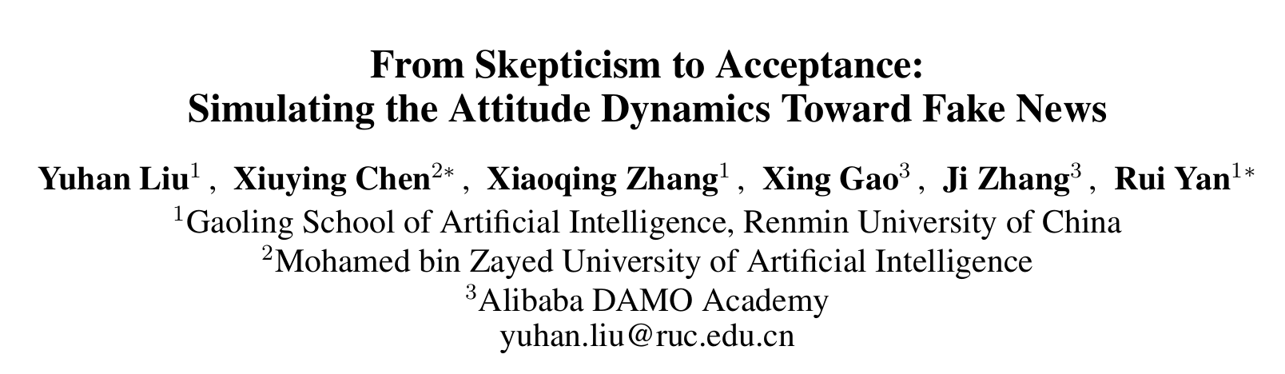
Presenter: 224030193 LEI Yuwei

Slide 84
Brief Introduction
LLM: This study introduces a Fake News Propagation Simulation (FPS) framework based on large language models (LLMs) to explore the trends and control mechanisms of fake news propagation.
Goal: 1.how individuals adopt or reject misinformation over time
2. evaluate the effectiveness of various intervention strategies.

Slide 85
01
Background & Related work
02
Method
03
Experiment
04
Analysis & Discussion
05
Conclusion

Slide 86


Background
Social media platforms: rapid spread of information
Both knowledge sharing and misinformation dissemination.
Fake news significant societal challenges
public perception,
election outcomes,
financial markets
emergency responses

Slide 87
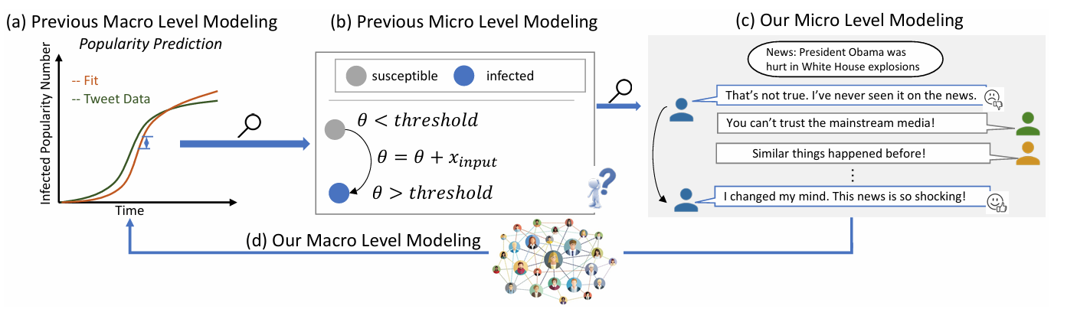
Related work
Fake News Detection: text analysis techniques for early detection of fake news and explore fine-grained reasoning methods to enhance detection capabilities.
Fake News Propagation Modeling: epidemic models (such as the SIR model), point process-based approaches, and diffusion models

Slide 88
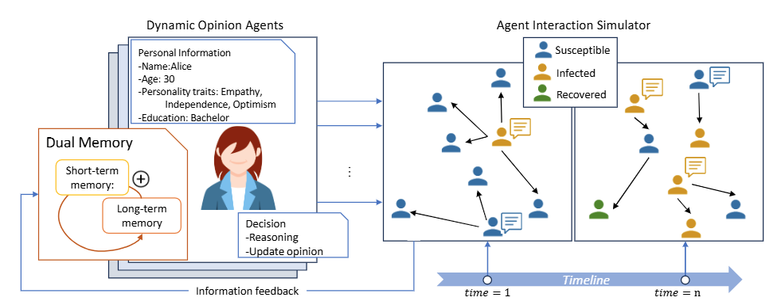
Method
FPS Framework: Fake News Propagation Simulation
simulate the spread of fake news in social networks.
The FPS framework consists of two core modules: DOA & AIS

Slide 89
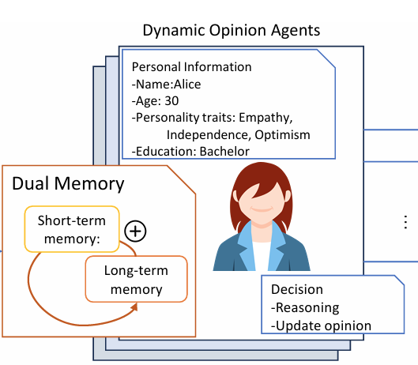
1. Dynamic Opinion Agent (DOA)
Simulate individual cognitive and decision-making processes in a social environment.
1. Each agent has a unique persona (age, educational background, personality traits, etc.).
2. Implements a dual memory system: short-term memory (summarizing daily interactions) and long-term memory (accumulating historical opinions).
3. Dynamically adjusts beliefs about fake news through reflection and reasoning.

Slide 90
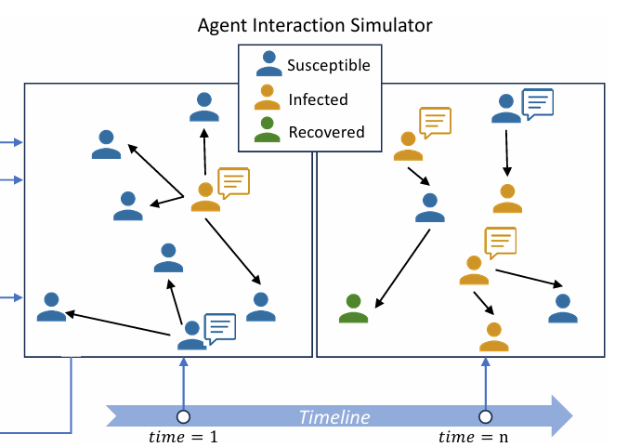
2. Agent Interaction Simulator (AIS)
Defines random interactions between individuals and simulates opinion evolution.
Employs a modified SIR propagation model (Susceptible-Infected-Recovered),.
Introduces an official intervention mechanism, simulating the role of authoritative entities in refuting fake news

Slide 91
Experiment
1. Macro-Level Observations
1.Topic Relevance Affects Propagation Speed:
Political fake news spreads twice as fast as misinformation related to science.
People are less skeptical of political misinformation compared to other topics.
2.Personality Traits Influence Susceptibility:
Agents with high agreeableness and high neuroticism (Credulous Trait) are more likely to believe in fake news.
Agents with low agreeableness and low neuroticism (Skeptical Trait) are more resistant to misinformation

Slide 92
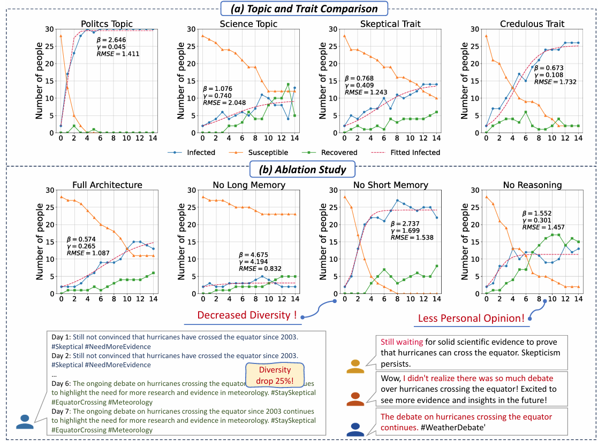

Slide 93
Experiment
2. Micro-Level Observations
Frequent Belief Switching Among Credulous Agents:
Individuals with credulous traits frequently change their opinions based on social influence.
Stable Opinions Among Skeptical Agents:
Skeptical agents tend to maintain a consistent stance, even when exposed to conflicting information

Slide 94
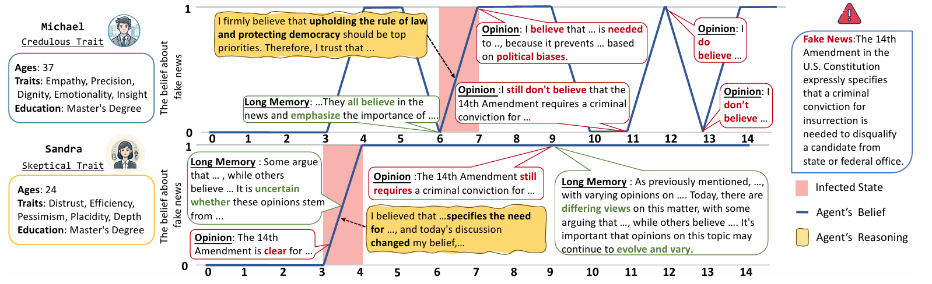

Slide 95
Experiment
3. Effectiveness of Fake News Interventions
Early intervention is the most effective strategy
Interventions at moderate frequencies (e.g., every three days) are nearly as effective as daily interventions, demonstrating that fact-checking does not need to be constant to be impactful.
Chronic Believers Exist: Approximately 50% of the infected group never change their opinion, even after multiple interventions. This suggests that some individuals are inherently resistant to fact-based corrections

Slide 96
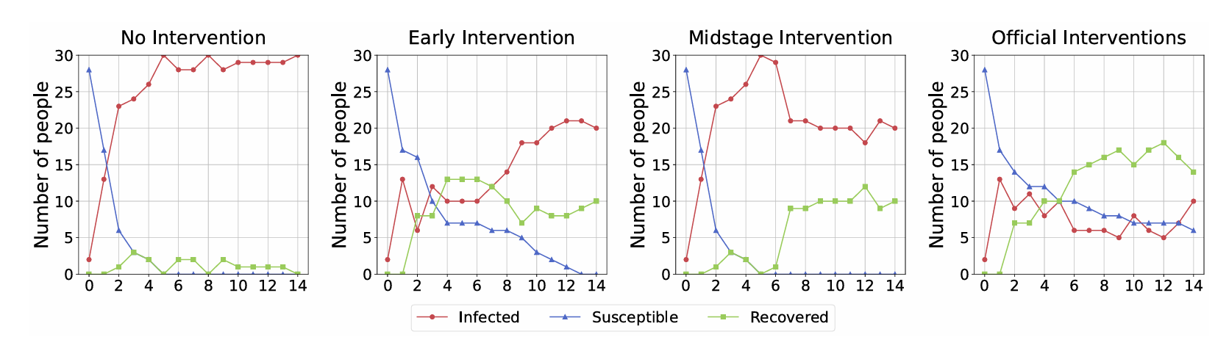

Slide 97
Implications and Discussion
Tailored Interventions Are Necessary: Since personality traits significantly influence susceptibility to fake news, interventions should be customized based on user profiles.
Early Detection and Prevention Are Key: Proactive fact-checking efforts before fake news gains momentum are crucial for mitigating its impact.
Public Awareness and Critical Thinking Should Be Promoted: Educating individuals about misinformation tactics can help reduce vulnerability to manipulation

Slide 98
Conclusion
To summarize, our study presents a novel LLM-based Fake News Propagation Simulation (FPS) framework that captures the dynamic evolution of beliefs in response to misinformation
Future work will focus on enhancing FPS with real-time social media data, expanding our study to include multi-platform misinformation ecosystems, and developing adaptive intervention strategies for personalized fact-checking.

Slide 99
1 v 1 Project Discussion (1-1.5hrs)

